Slide 1

TKR COLLEGE OF ENGINEERING AND TECHNOLOGY
(Autonomous, Accredited by NAAC with ‘A’ Grade)
Department of Computer Science & Engineering
B. Tech IV Year II Semester
Project Part B

Slide 2
REVIEW - 3

Slide 3
PROJECT GUIDE:
Dr. CHAGANTI B N LAKSHMI
TEAM DETAILS:
ROLL.NO | STUDENT NAME
19K91A0549 | CH SRIJAN (Team Leader)
19K91A05O5 | AFSHA
19K91A0506 | AILA VIGNESH
19K91A0555 | DAMERA RAJU

Slide 4
PROJECT TITLE
A MODEL TO PREDICT HEART DISEASE USING MACHINE LEARNING
TEAM NO : A9
BRANCH/SEC : CSE-A

Slide 5
CODING

Slide 6
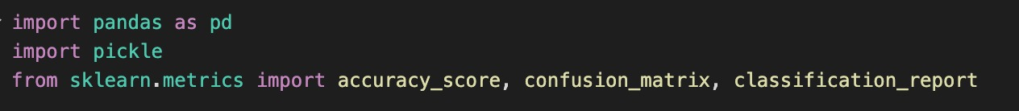
Importing the Modules
Pandas is a Python library used for working with data sets. It has functions for analyzing, cleaning, exploring, and manipulating data
Pickling is the process whereby a Python object hierarchy is converted into a byte stream
Scikit-learn is probably the most useful library for machine learning in Python. The sklearn library contains a lot of efficient tools for machine learning and statistical modeling including classification, regression, clustering and dimensionality reduction.
Sklearn.metrics module implements several loss, score, and utility functions to measure classification performance.

Slide 7

Loading The Data
pandas provides the read_csv function to read data stored as a csv file into a pandas DataFrame.

Slide 8
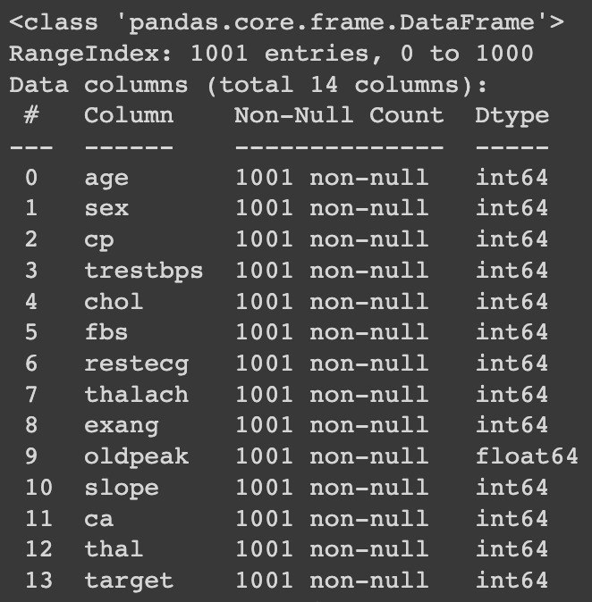

The info() method prints information about the DataFrame. The information contains the number of columns, column labels, column data types, memory usage, range index, and the number of cells in each column (non-null values). Note: the info() method actually prints the info.

Slide 9

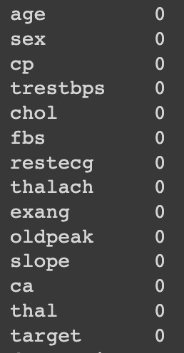
isnull()
The isnull() method returns a DataFrame object where all the values are replaced with a Boolean value True for NULL values, and otherwise False.
While making a Data Frame from a csv file, many blank columns are imported as null value into the Data Frame which later creates problems while operating that data frame.

Slide 10
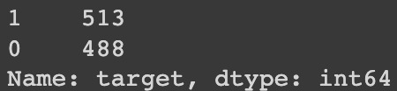
Target counts
Return a Series containing counts of unique rows in the DataFrame.

Slide 11
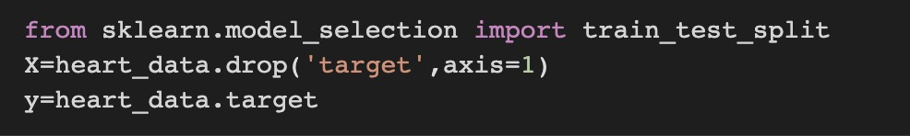
Splitting the Data

Slide 12
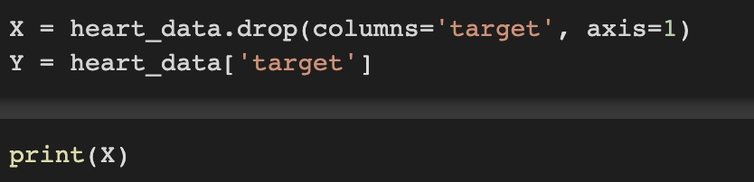
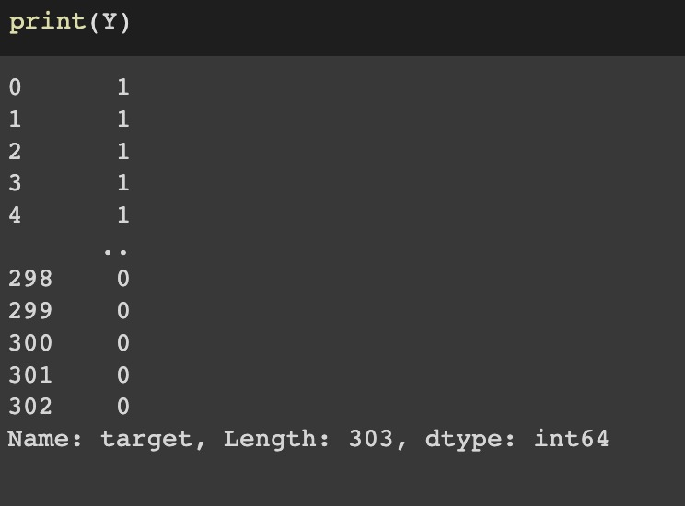
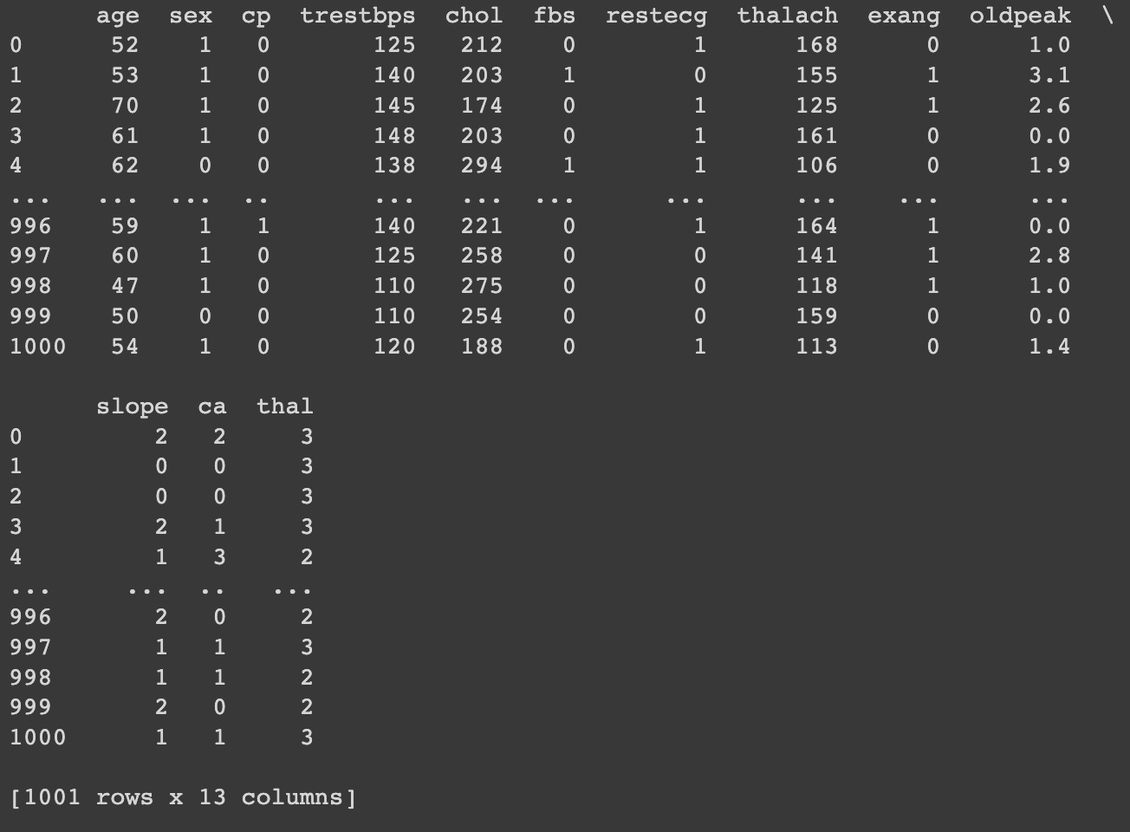
Splitting Features and Target

Slide 13
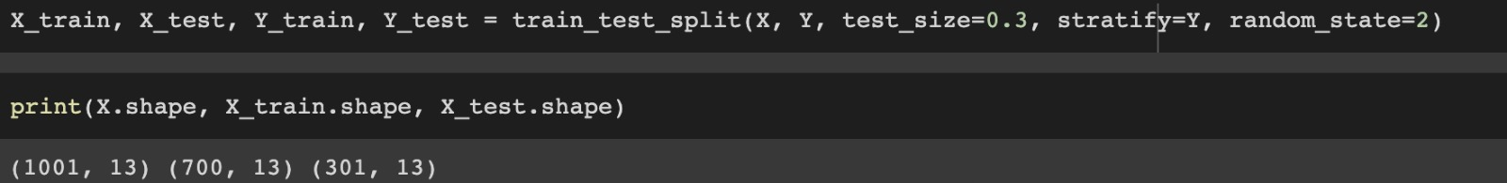
Splitting the data into Training Data and Test Data

Slide 14
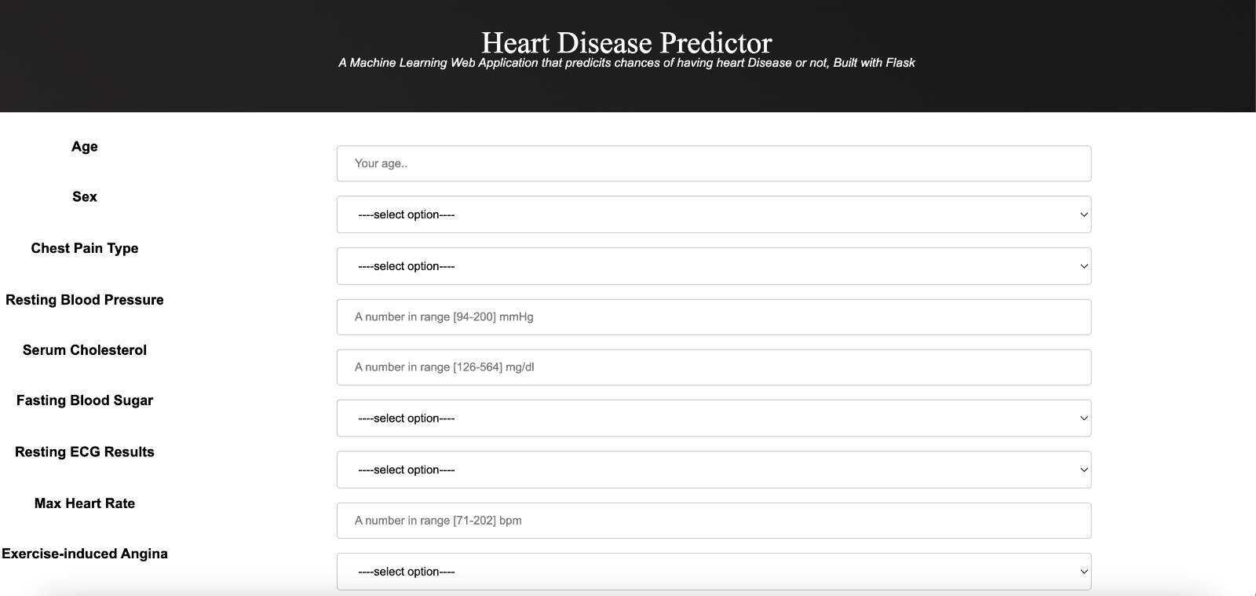
FRONT END

Slide 15
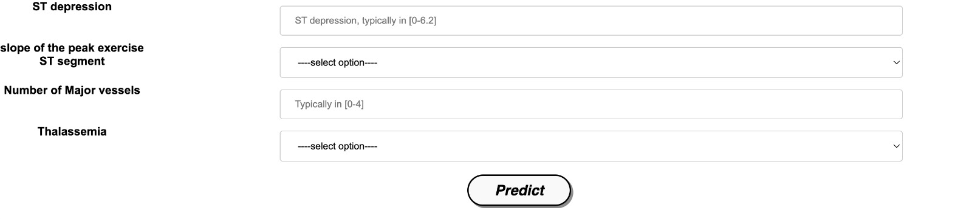

Slide 16
THANK YOU

